Slide 1

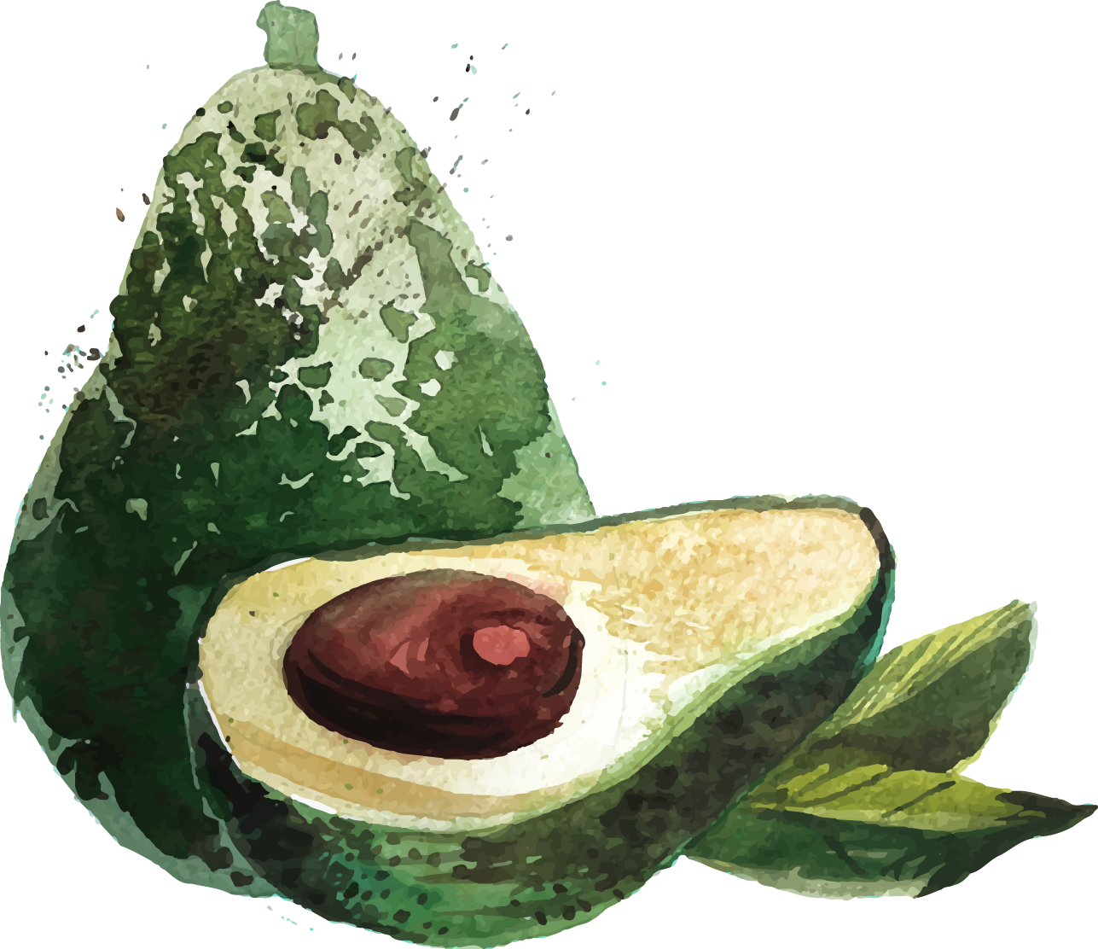
Avocado Price Prediction
Noura Muhammad Alhammad

Slide 2

TABLE OF CONTENTS
01
02
03
Design
Data
Tools
04
05
06
Algorithms
Conclution
Q&A

Slide 3

01
Design

Slide 4
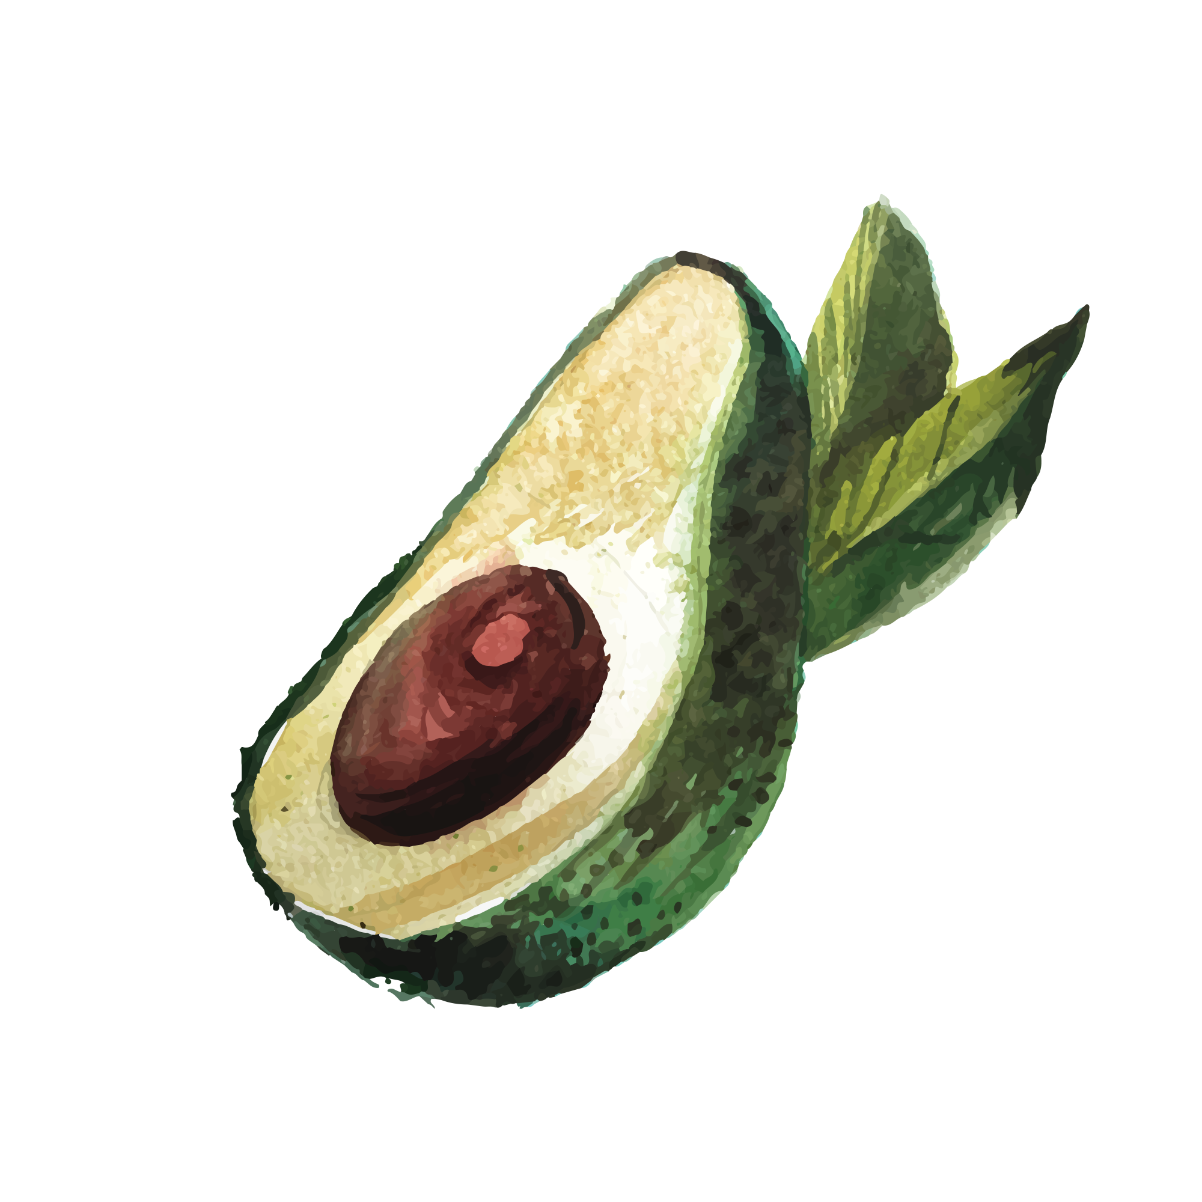
Design
Project purpose
This project represents the price of avocado over the week, and the purpose is to predict the future price of avocado based on the product number and assign if the avocado is conventional or organic.
Reviews the avocado prices in detail, it presents to the people who love avocado and make it easier for them to enjoy with cheap avocados.

Slide 5
02
Data

Slide 6
Data Feature
# | Feature Name | Description | Data Type
1 | Date | The date of the observation. | Object
2 | AveragePrice | The average price of a single avocado. | Float
3 | Type | The type of avocado (Conventional or Organic). | Object
4 | Year | The year of the observation. | Integer
5 | Region | The city or region of the observation. | Object
6 | Total Volume | Total number of avocados sold. | Float
7 | 4046 | Total number of avocados with PLU* 4046 sold. | Float
8 | 4225 | Total number of avocados with PLU 4225 sold. | Float
9 | 4770 | Total number of avocados with PLU 4770 sold. | Float
* PLU means: Price look-up codes

Slide 7
Data
 | Date | AveragePrice | Total Volume | 4046 | 4225 | 4770 | type | year | region
0 | 2015-12-27 | 1.33 | 64236 | 1036 | 54454 | 48 | conventional | 2015 | Albany
1 | 2015-12-20 | 1.35 | 54876 | 674 | 44638 | 58 | conventional | 2015 | Albany
2 | 2015-12-13 | 0.93 | 118220 | 794 | 109149 | 130 | conventional | 2015 | Albany
3 | 2015-12-06 | 1.08 | 78992 | 1132 | 71976 | 72 | conventional | 2015 | Albany
The data set contain 18249 data point with 14 features.

Slide 8
Data
Avocado Dataset
This data was downloaded from the Hass Avocado Board website in May of 2018 & compiled into a single CSV and published in Kaggle.

Slide 9
Data Cleaning
Avocado Dataset
Checking for missing.
Checking duplicates.
No missing
No duplicates

Slide 10
03
Tools

Slide 11



Tools Used
Environment
Language
Data Processing
Jupyter Notebook
Pandas – Numpy
Python

Slide 12


Tools Used
Modeling
Visualization
Matplotlip – Seaborn
Scikit-learn

Slide 13
04
Algorithm

Slide 14
Algorithm
Model used
Linear Regression.
Random Forest.
XGB Regressor.

Slide 15
EDA
Exploratory Data Analysis

Slide 16
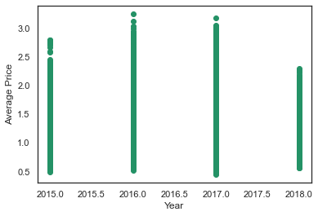
Scatter Plot

Slide 17
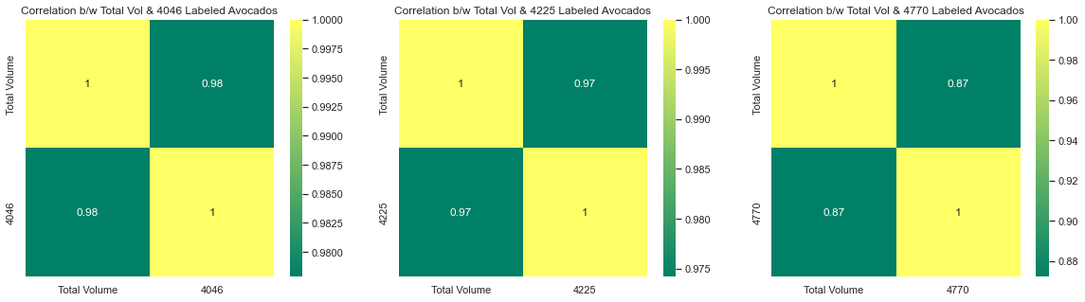
Correlation

Slide 18
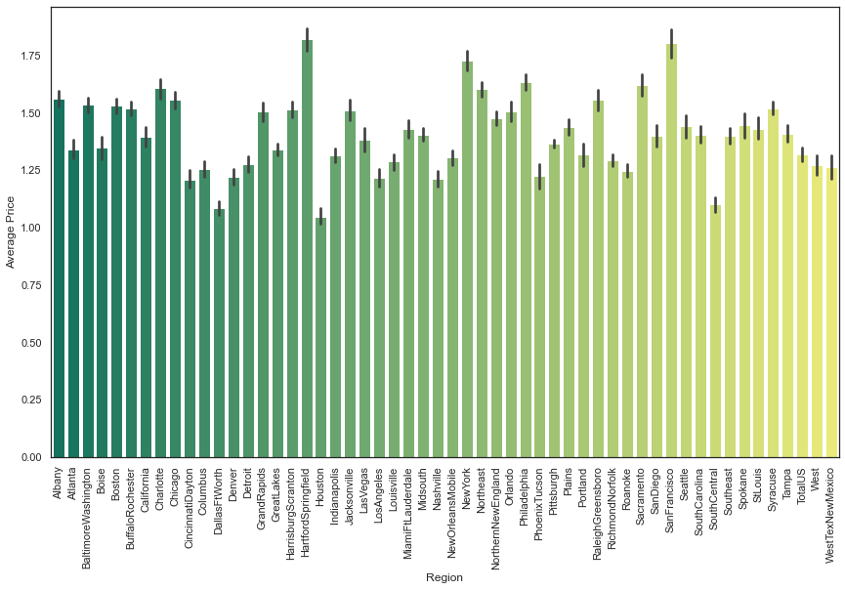
First Question: Is the geography influence the price?

Slide 19
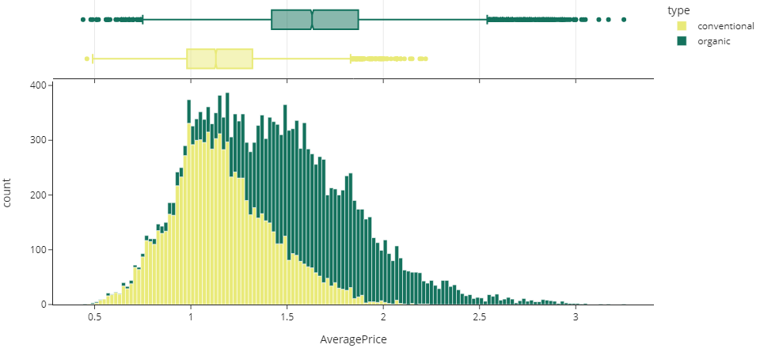
Second Question: which avocado type is more expensive?

Slide 20
MODEL

Slide 21
Model
 | Date | AveragePrice | Total Volume | 4046 | 4225 | 4770 | type | year | region | seasons
0 | 2015-12-27 | 1.33 | 64236 | 1036 | 54454 | 48 | conventional | 2015 | Albany | 0
1 | 2015-12-20 | 1.35 | 54876 | 674 | 44638 | 58 | conventional | 2015 | Albany | 0
2 | 2015-12-13 | 0.93 | 118220 | 794 | 109149 | 130 | conventional | 2015 | Albany | 0
3 | 2015-12-06 | 1.08 | 78992 | 1132 | 71976 | 72 | conventional | 2015 | Albany | 0
Create a new column to applying the Linear Regression, if season = 0 it’s spring, 1 for summer, 2 for fall and 3 for winter.

Slide 22
Model Performance
Model | Using R2
Linear Regression | 0.60
Random Forest Regressor | 0.90
XGB Regressor | 0.90
The both regressors Random Forest and XGB got the same score, which mean their performance is comparable.

Slide 23
05
Conclosuion

Slide 24
Conclosuion
Avocado Predict Price
The questions were answered clearly.
For next step may create a form to making search easier to people who interesting avocado to enter the avocado product number and got a brief describe about it.

Slide 25
06
Q&A

Slide 26
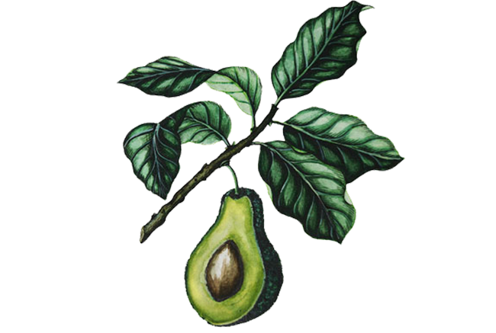
Thank You!
Do you Have Any Question?

